Slide 1
TRAINING PRESENTATION ON INDIA TOUR
DALJIT KAUR
1905925

Slide 2
INTRODUCTION TO PROJECT
INDIA TOUR: Tourism in India is important for the country’s economy and its growing rapidly.
The word travel and tourism council calculated that tourism generated 16.91 lakh crore(u$$220 billion) or9.2% of india GDP in2018 and supported 42.673 million jobs,8.1% of its total employment .

Slide 3
HARDWARE AND SOFTWARE REQUIREMENT
1. Hardware requirement:
PROCESSOR:- Pentium IV,70 MHz or higher
RAM:- IGB or higher
HARD DISK:-40GB or higher
2. Software requirement:
Operating system:-Window XP (or higher)
Web browser:- Google chrome

Slide 4
CONTENT
Tools
- Microsoft visual studio(VSC)
Technologies
- Front end
- Back end(still working)

Slide 5
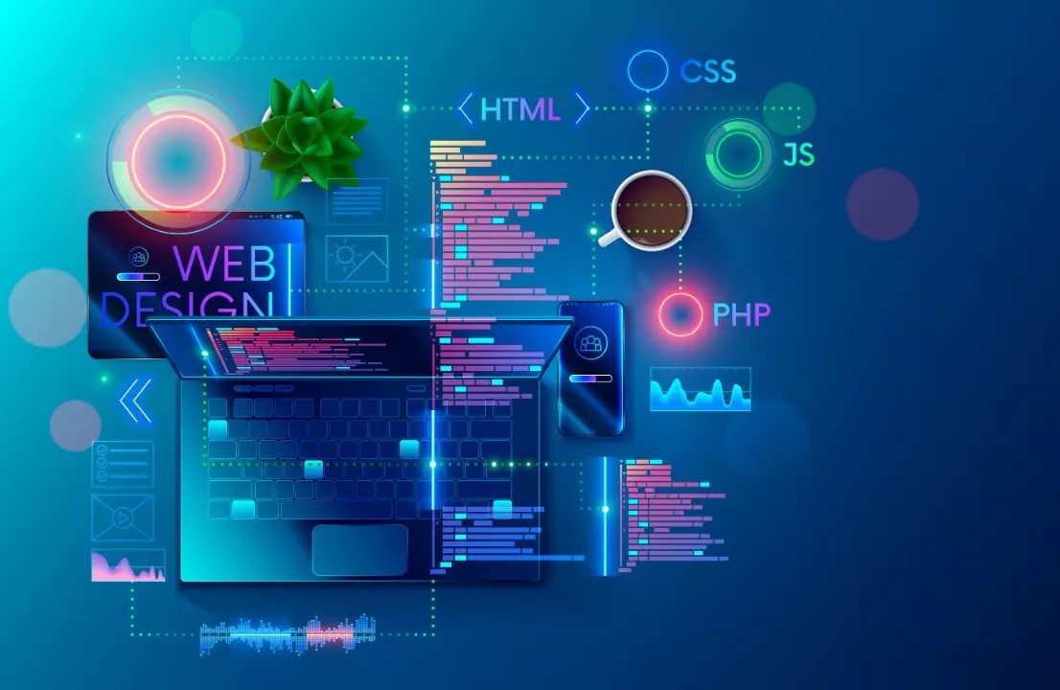
INTRODUCTION TO TOOLS

Slide 6
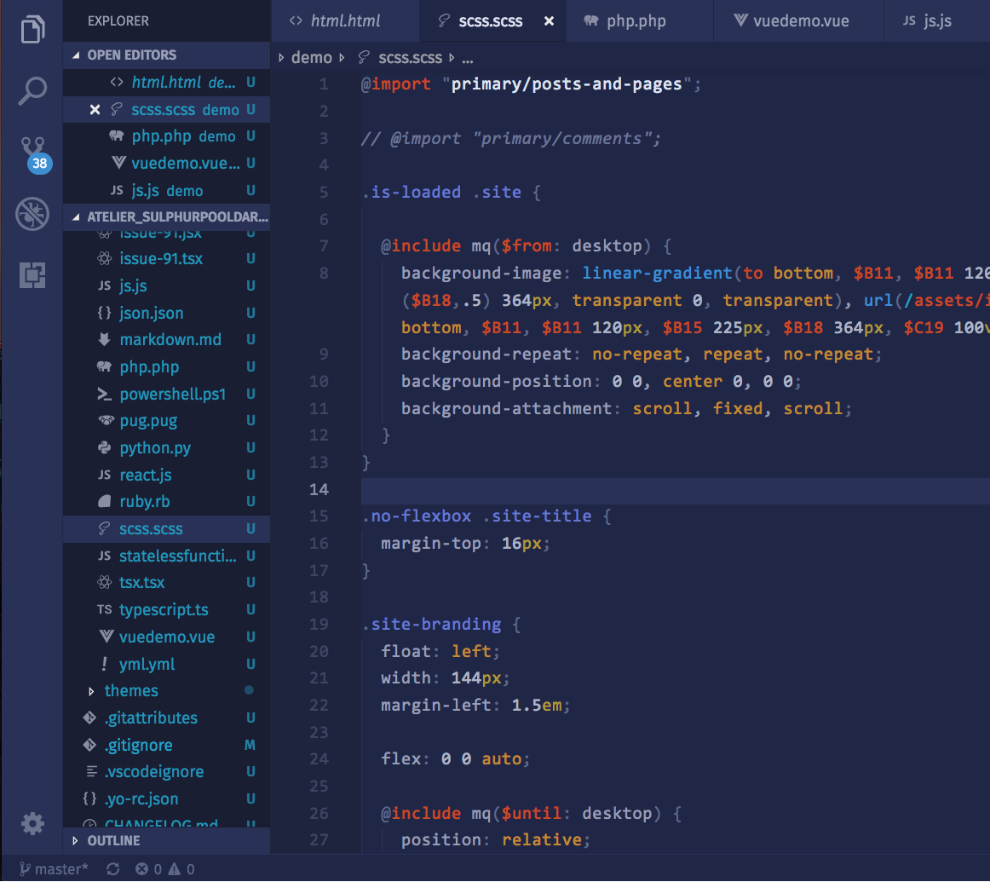
MICROSOFT VISUAL STUDIO
Microsoft Visual Studio is an integrated development environment from Microsoft. it is used to develop computer programs, as well as websites, web apps, web services, and mobile apps.
visual studio uses Microsoft software development platforms such as windows app window forms, window presentation foundation, windows stores, and Microsoft Silverlight. it can produce both native codes and managed code.
Features of vs code:
Code manager
Debugger
Designer

Slide 7
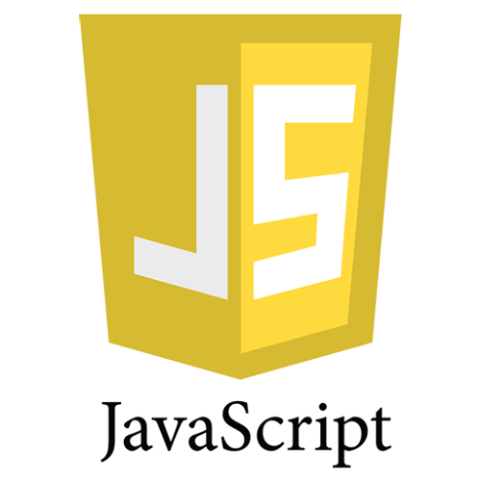
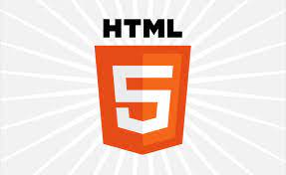
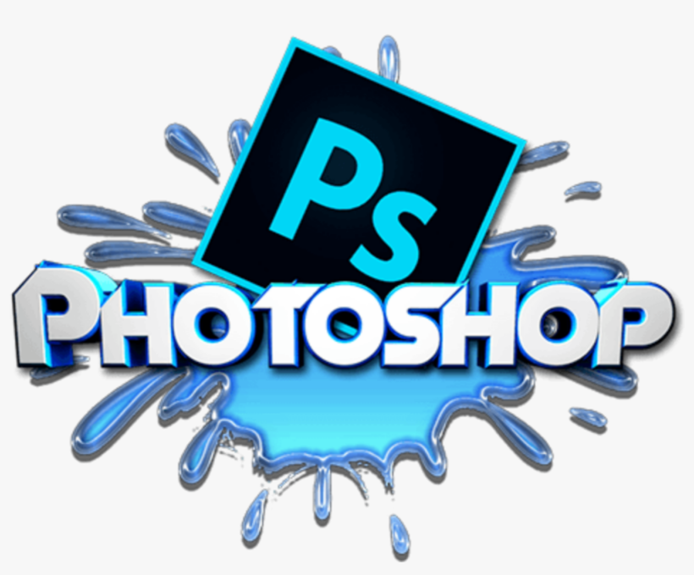
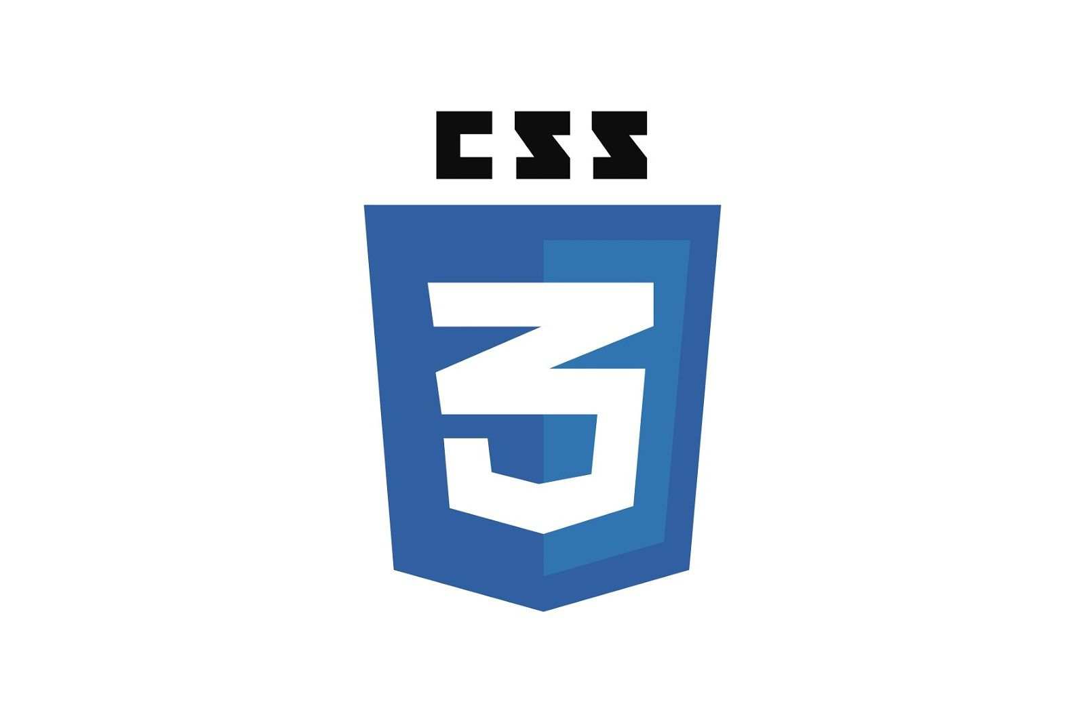
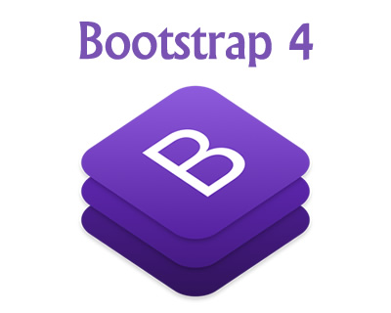

TECHNOLOGIES
HTML5
CSS3
JAVA SCRIPT
BOOTSTRAP
JQUERY
PHOTOSHOP

Slide 8
HTML
HTML stands for hyper text markup language.
HTML for creating Web pages.
HTML describes the structure of a Web page.
HTML consists of a series of elements.
HTML elements tell the browser how to display the content.
HTML elements label pieces of content such as "this is a heading", "this is a paragraph", "this is a link", etc.
EXAMPLE
<!DOCTYPE html>
<html> <head> <title>Page Title</title> </head> <body> <h1>My First Heading</h1> <p>My first paragraph.</p> </body> </html>

Slide 9
CSS (cascading style sheet)
CSS stands for Cascading Style Sheets.
CSS describes how HTML elements are to be displayed on screen, paper, or in other media.
CSS saves a lot of work. It can control the layout of multiple web pages all at once.
External stylesheets are stored in CSS files.
EXAMPLE
body { background- color:lightblue; } h1 { color: white; text-align: center; } p { font-family: verdana; font-size: 20px;

Slide 10
JAVA SCRIPT
JavaScript is the Programming Language for the Web.
JavaScript can update and change both HTML and CSS.
JavaScript can calculate, manipulate and validate data.
JavaScript is easy to learn.

Slide 11
BOOTSTRAP
Bootstrap is a free and open-source CSS framework directed at responsive, mobile-first front-end web development.
It contains HTML, CSS, and JavaScript-based design templates for typography, forms, buttons, navigation, and other interface components.
Bootstrap is the most popular CSS framework for developing responsive and mobile-first websites.
Bootstrap 5 is the newest version of Bootstrap

Slide 12
JAQUERY
jQuery is a fast, small, and feature-rich JavaScript library
It makes things like HTML document traversal and manipulation, event handling, animation, and Ajax much simpler with an easy-to-use API that works across a multitude of browsers.
The jQuery library contains the following features:
HTML/DOM manipulation
CSS manipulation
HTML event methods
effects and animations
AJAX
Utilities

Slide 13
PHOTOSHOP
Photoshop is a photo editing and raster graphic design software which allows users to create, edit, and manipulate various graphics as well as digital art.
It also allows to create and edit raster images with multiple layers and import the images in various file formats
Photoshop is developed by Adobe Systems for both Windows and MacOS.

Slide 14
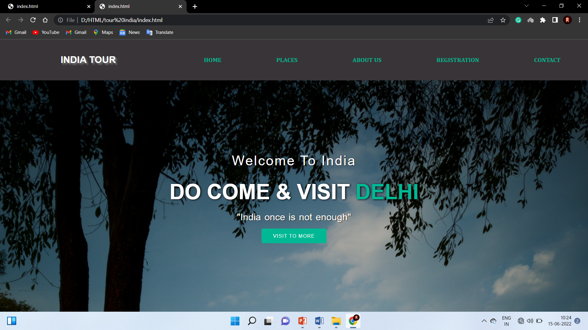
SCREENSHOT

Slide 15
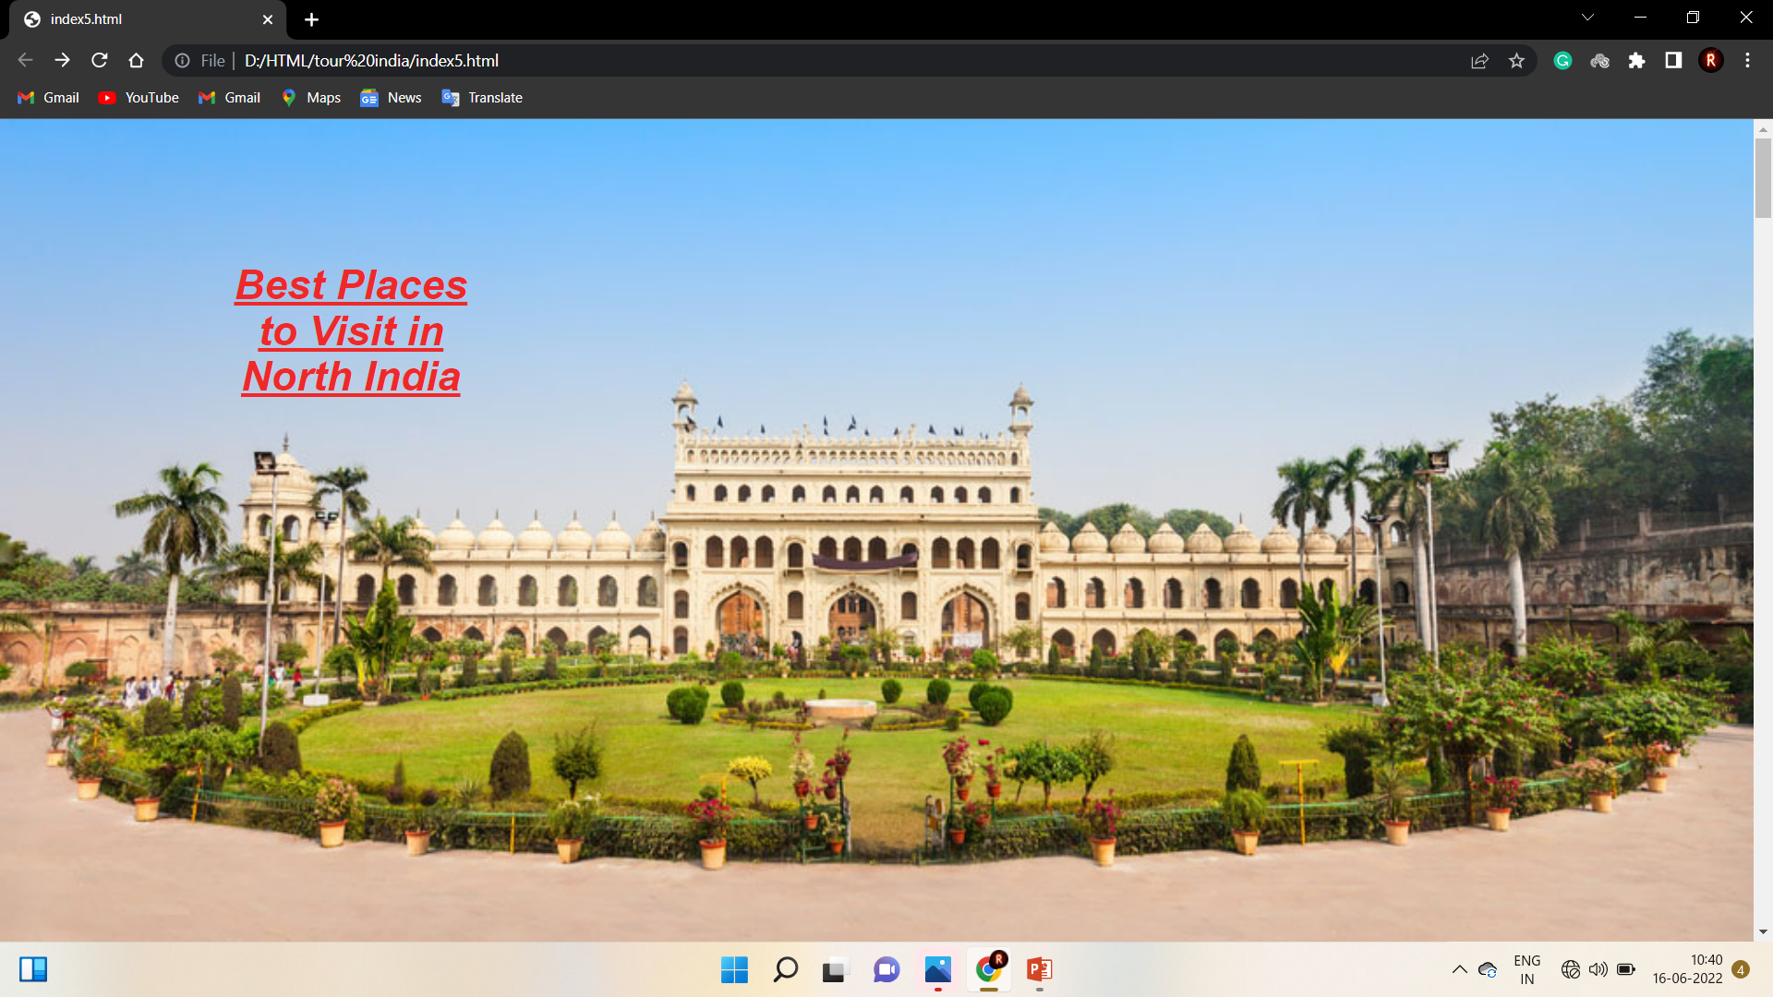

Slide 16
THANK YOU

